Slide 1
Emulsions

Slide 2

By the end of this lesson you should be able to:
1. | Explain how an emulsion is made.
2. | Explain the difference between a stable colloid and an unstable colloid.

Slide 3


Slide 4
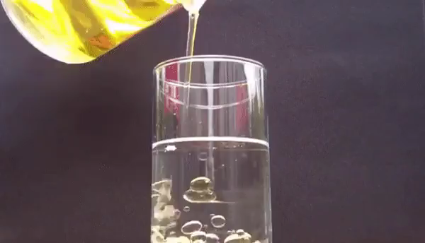
It is important to mention that colloids are not totally stable.
We often say they are as a way of telling suspensions and colloids apart.
Suspensions will separate very quickly, while colloids take a much longer time. This is why we can have stable and unstable colloids.

Slide 5
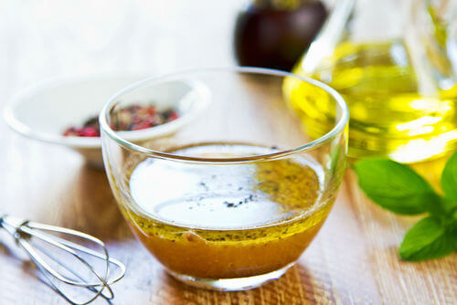
Stable colloids will stay together for most of their existence (e.g. mayonnaise).
Unstable colloids start off mixed, but eventually the particles separate and form layers (e.g. salad dressing).
Emulsions can be stable or unstable.

